Slide 1
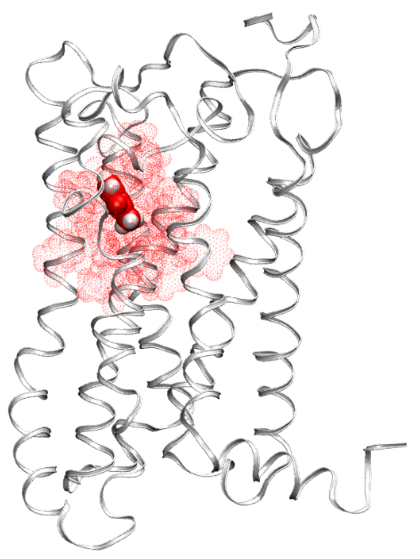
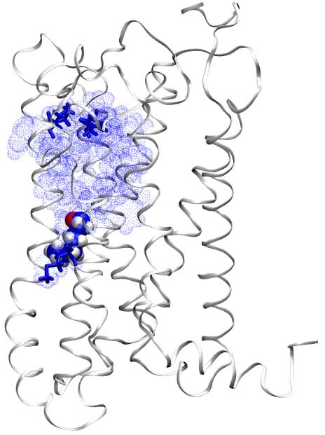
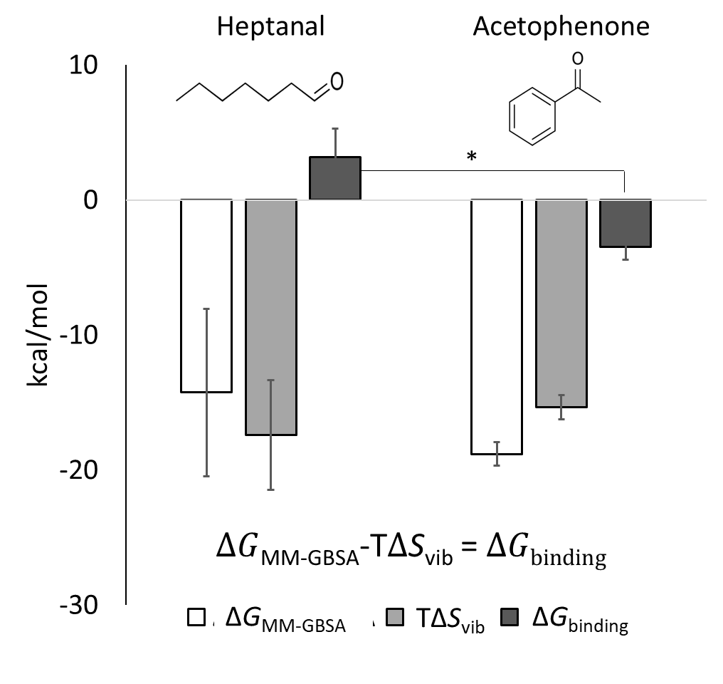
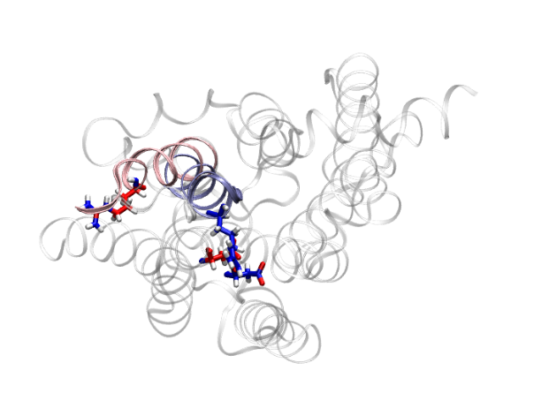
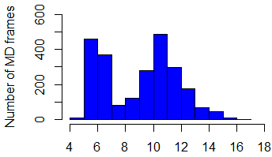
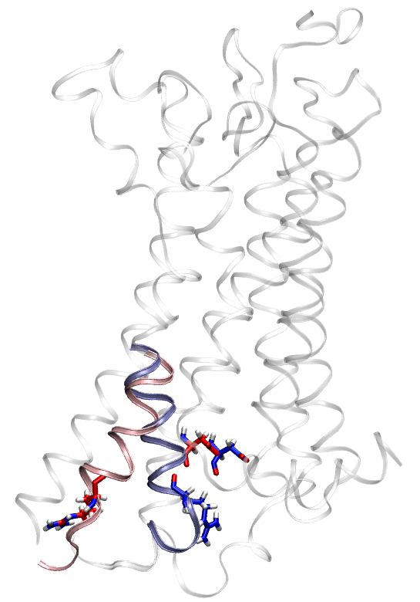
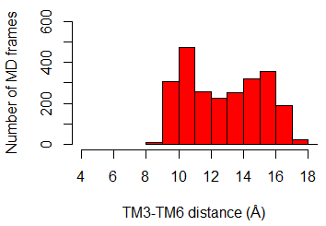
A
B
H165^{4.55}
C
V205^{5.39}
M252^{6.42}
D
H165^{4.55}
M252^{6.42}
V205^{5.39}
E
F
Heptanal
TM3-TM6
distance
TM6
acetophenone
bound
TM6
heptanal
bound
Acetophenone
D127^{3.49}
90°
R240^{6.30}
R240^{6.30}

Slide 2
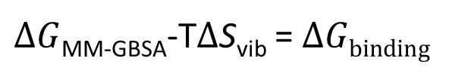
*
$∆G$_{MM-GBSA}-T$∆$S_{vib} = $∆Gbinding$
ΔG_{MM-GBSA}
TΔS_{vib}
ΔG_{binding}

